Slide 1


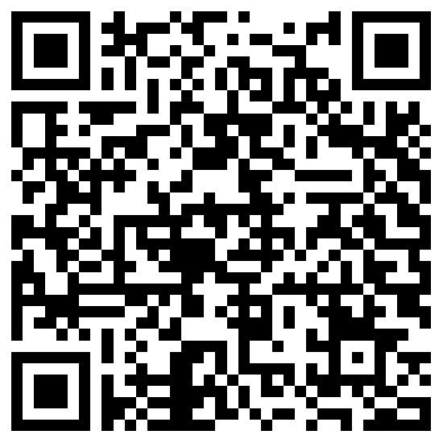
NISM-Series-XXV-A: Persons Associated With Research Services (Sales and Other non-core Services) Certification (Training)
Scan for Google
Scan for Register

Slide 2
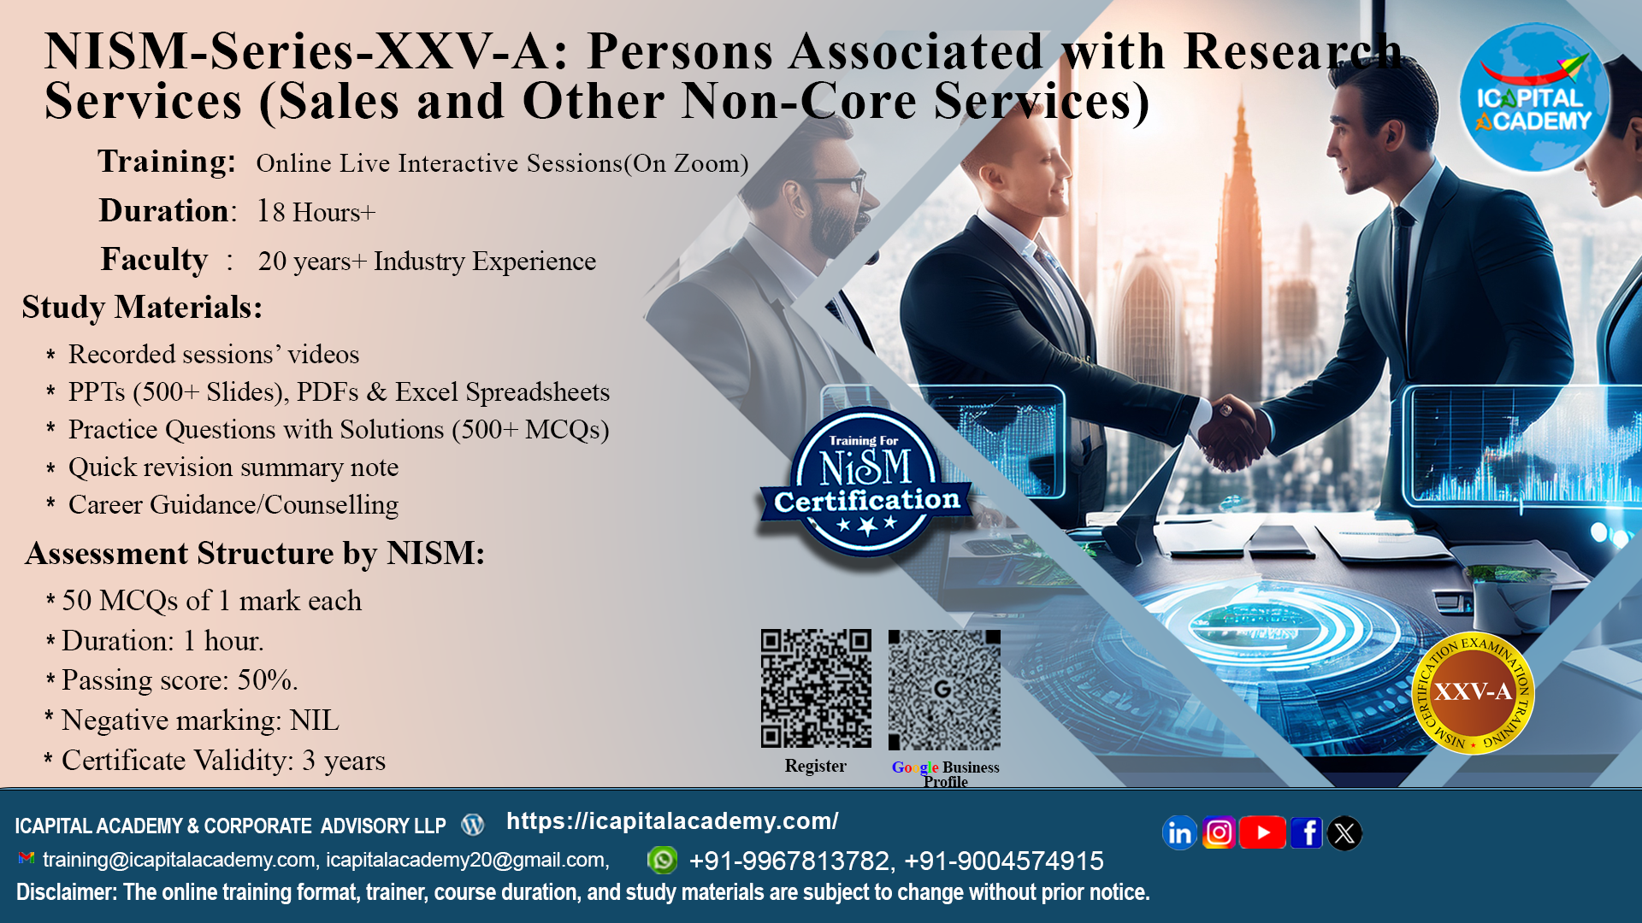

Slide 3
Key highlights :
Training Sessions : Online Live Interactive Sessions + Online Self – paced.
Duration : 18+ Hours
Faculty : 20+ year of experience

Slide 4
Curriculum :
Session 1: Introduction to Research Analysis Profession and Securities Markets.
Session 2: Fundamentals of Research, Market Terminologies and Market Analysis.
Session 3: Risk and Return Fundamentals.
Session 4: Research Reporting, Ethics, and Regulatory Environment.
Session 5: Client Interaction and Relationship Skills.
Session 6: Professional Efficiency, Development, and Tools.

Slide 5
Study Materials :
Recording available of online live sessions (for 90 days)
PPTs (500+ slides), PDFs & Excel spreadsheets.
500+ MCQs with explanation
Quick revision summary notes.
Career Guidance/Counselling

Slide 6
Assessment Details :
Maximum Marks: 50
50 MCQs of 1 mark each
Duration: 1 hour
Passing score: 50%
Passing Marks: 25
Negative Marking: NIL
Certificate Validity: 3 years

Slide 7
Upon successful completion of the training, candidates will :
Know the regulatory framework governing research services under the SEBI (Research Analysts) Regulations, 2014;
Understand the ethical standards, compliance requirements, and conduct obligations applicable to research services;
Understand the roles, responsibilities, and permitted activities of Persons Associated with Research Services, particularly in sales and other non-core functions;
Know the importance of regulatory compliance, investor protection, and confidentiality in research-related activities.

Slide 8
ARE YOU ELIGIBLE ?
NISM-Series-XXV-A: Persons Associated with Research Services (Sales and Other Non-Core Services) Certification Examination only caters to Persons Associated with Research Services who perform sales and other non-core services. This examination aims to establish a minimum knowledge benchmark for the persons associated with research services, defined under Regulation 2(ne) of the SEBI (Research Analysts) Regulations, 2014.

Slide 9
About NISM :
NISM is a public trust established in 2006 by SEBI to enhance standards in India’s securities markets.
It undertakes wide-ranging capacity-building activities for market participants.
Programmes include residential PG courses, short-term training, and faculty development.
NISM offers 29 SEBI-mandated and voluntary certifications through 250+ test centers nationwide.
It manages six schools of excellence for specialized training.
NISM is expanding globally to become a premier financial education hub.

Slide 10
About ICAPITAL Academy:
ICAPITAL Academy & Corporate Advisory LLP, established in October 2020, is a premier institution in financial education and advisory.
Specializes in NISM certification preparation, capital markets training, and applied finance programs. Offers industry-relevant courses in Financial Modeling, Equity Research, Derivatives, Forex, Technical & Fundamental Analysis, and Mutual Funds.
Provides self-paced, live online, and classroom-based learning formats for diverse learner needs. Delivers corporate training solutions focused on workforce upskilling, leadership development, and customized financial competency programs.
Advisory services span financial research, personal finance, project finance, loan syndication, debt restructuring, and strategic corporate planning.
Mission: To foster global financial excellence through quality education and professional empowerment.

Slide 11
Do you want to know more ?
Scan for Google
Scan for Register

Slide 12
