Slide 1


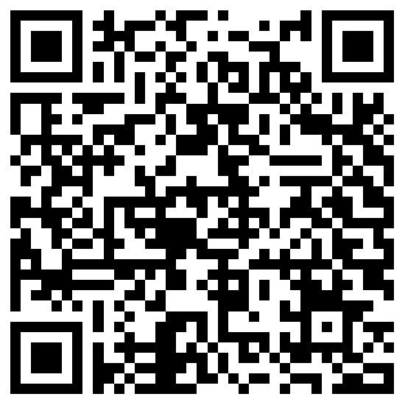
NISM-Series-XII:
Securities Markets Foundation
Certification (training)
Scan for Google
Scan for Register

Slide 2
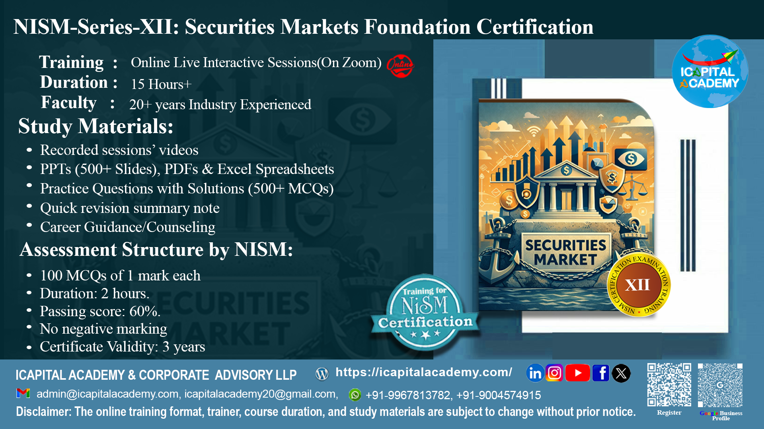

Slide 3
Key Highlight :
Training session : Online Live Interactive Session + Online Self – paced.
Duration : 15+ hours
Faculty : 20+ years of experience.

Slide 4
Study Materials:
Recording available of online live sessions (for 90 days)
PPTs (500+ slides), PDFs & Excel spreadsheets.
500+ MCQs with explanation
Quick revision summary notes.
Career Guidance/Counseling

Slide 5
Assessment Details :
100 MCQs of 1 mark each
Duration: 2 hours
Passing score: 60%
No Negative Marking
Certificate Validity: 3 years

Slide 6
Curriculum :
Understanding securities markets and performance
Securities: types, features and concepts of asset allocation and investing
Primary markets
Secondary markets
Mutual funds
Derivative markets

Slide 7
Upon successful completion of the training, candidates will :
Know the basics of the Indian Securities Markets.
Know the various processes involved in Primary and Secondary Markets
Understand the schemes and products in Mutual Funds and Derivatives Markets in India.
Know the steps in financial planning process.

Slide 8
Are you eligible ?
NISM-Series-XII: Securities Markets Foundation Certification Examination is for entry level professionals, who wish to make a career in the securities markets. This certification examination will also be useful to all those individuals who are interested in acquiring a basic knowledge of the Indian Securities markets.

Slide 9
About NISM :
NISM is a public trust established in 2006 by SEBI to enhance standards in India’s securities markets.
It undertakes wide-ranging capacity-building activities for market participants.
Programes include residential PG courses, short-term training, and faculty development.
NISM offers 29 SEBI-mandated and voluntary certifications through 250+ test centers nationwide.
It manages six schools of excellence for specialized training.
NISM is expanding globally to become a premier financial education hub.

Slide 10
About ICAPITAL Academy:
ICAPITAL Academy & Corporate Advisory LLP, established in October 2020, is a premier institution in financial education and advisory.
Specializes in NISM certification preparation, capital markets training, and applied finance programs. Offers industry-relevant courses in Financial Modeling, Equity Research, Derivatives, Forex, Technical & Fundamental Analysis, and Mutual Funds.
Provides self-paced, live online, and classroom-based learning formats for diverse learner needs. Delivers corporate training solutions focused on workforce upskilling, leadership development, and customized financial competency programs.
Advisory services span financial research, personal finance, project finance, loan syndication, debt restructuring, and strategic corporate planning.
Mission: To foster global financial excellence through quality education and professional empowerment.

Slide 11
Do you want to know more ?
Scan for Google
Scan for Register

Slide 12
