Slide 1


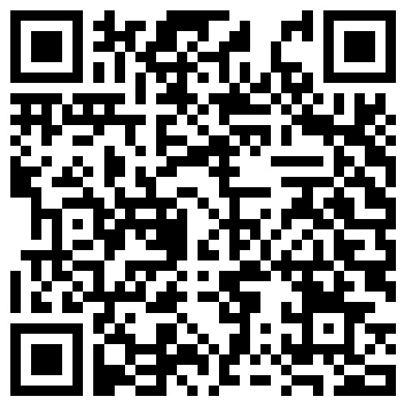
NISM-Series-V-B:
Mutual Fund Foundation
Certification (Training)
Scan for Google
Scan for Register
NISM Certification Examination - Mandated By SEBI

Slide 2
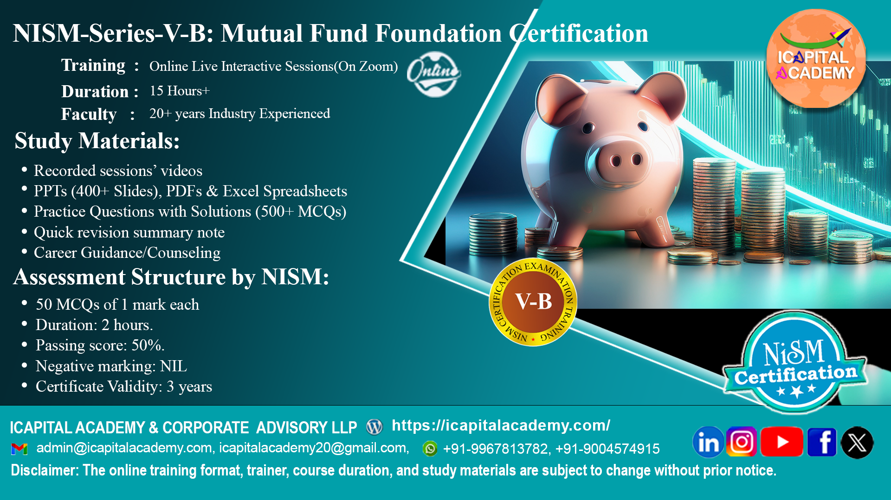

Slide 3
Key Highlights :
Training Session : Online Live Interactive Sessions + Online Self – paced.
Duration : 18 Hours+
Faculty : 20+ years of experience.

Slide 4
Curriculum :
Investment Landscape
Concept and Role of a Mutual Fund
Legal Structure of Mutual Funds in India
Mutual Fund Products for the New Cadre of Distributors
Scheme Related Information
Fund Distribution and Channel Management Practices
Performance of Mutual Funds
Taxation
Investor Services
Legal and Regulatory Environment

Slide 5
Study Materials:
Recording available of online live sessions (for 90 days)
PPTs (400+ slides), PDFs & Excel spreadsheets.
500+ MCQs with explanation
Quick revision summary notes.
Career Guidance/Counseling

Slide 6


Assessment Details:
50 MCQs of 1 mark each
Duration: 2 hours
Passing score: 50%
Negative Marking: NIL
Certificate Validity: 3 years

Slide 7
Upon successful completion of the training, candidates will :
Know the basics of mutual funds, their role and structure, different kinds of mutual fund schemes and their features.
Know how mutual funds are distributed in the market-place, how specified schemes are to be evaluated and how suitable schemes can be recommended by this cadre of distributors to prospective investors.
Know the rules and regulations related to the distribution of specified products.
Know the basics of financial planning as an approach to investing in mutual funds.

Slide 8
Are you eligible ?
The following persons can take NISM-Series-V-B: Mutual Fund Foundation Certification Examination:
Postal agents
Retired government and semi-government officials (class III and above or equivalent) with a service of at least 10 years
Retired teachers with a service of at least 10 years
Retired bank officers with a service of at least 10 years, and other similar persons (such as Bank correspondents) as may be notified by AMFI/AMC from time to time
Any other individuals.

Slide 9
About nism :
NISM is a public trust established in 2006 by SEBI to enhance standards in India’s securities markets.
It undertakes wide-ranging capacity-building activities for market participants.
Programes include residential PG courses, short-term training, and faculty development.
NISM offers 29 SEBI-mandated and voluntary certifications through 250+ test centers nationwide.
It manages six schools of excellence for specialized training.
NISM is expanding globally to become a premier financial education hub.

Slide 10
About ICAPITAL Academy:
ICAPITAL Academy & Corporate Advisory LLP, established in October 2020, is a premier institution in financial education and advisory.
Specializes in NISM certification preparation, capital markets training, and applied finance programs. Offers industry-relevant courses in Financial Modeling, Equity Research, Derivatives, Forex, Technical & Fundamental Analysis, and Mutual Funds.
Provides self-paced, live online, and classroom-based learning formats for diverse learner needs. Delivers corporate training solutions focused on workforce upskilling, leadership development, and customized financial competency programs.
Advisory services span financial research, personal finance, project finance, loan syndication, debt restructuring, and strategic corporate planning.
Mission: To foster global financial excellence through quality education and professional empowerment.

Slide 11
Do you want to know more ?
Scan for Google
Scan for Register

Slide 12
