Slide 1





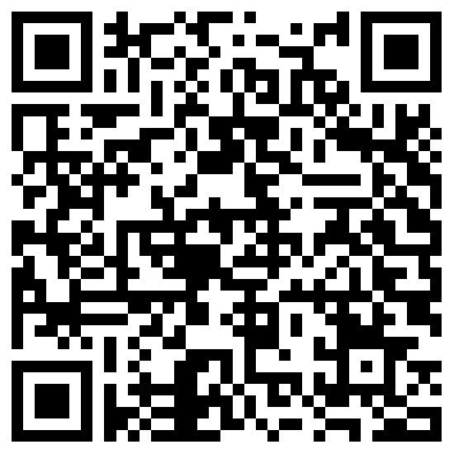
NISM-Series-IV:
Interest Rate Derivatives
Certification (Training)
Scan for Google
NISM Certification Examination - Mandated By SEBI
Scan for Register

Slide 2
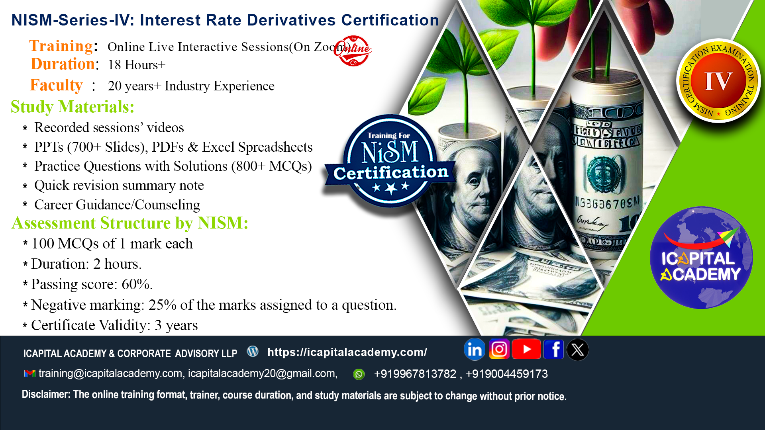

Slide 3
Key Highlights :
Training Session : Online Live Interactive Sessions + Online Self – paced.
Duration : 18 Hours+
Faculty : 20+ years of experience.

Slide 4
Curriculum :
Interest Rates & Fixed Income
Interest Rate Derivatives
Interest Rate Options
Trading Strategies
Trading Mechanism
Clearing & Settlement
Regulatory Framework
Accounting & Taxation
Investor Protection & Code of Conduct

Slide 5
Study Materials :
Recording available of online live sessions (for 90 days) .
PPTs (700+ slides), PDFs & Excel spreadsheets.
800+ MCQs with explanation .
Quick revision summary notes .
Career Guidance/Counseling .

Slide 6
Assessment Details :
100 MCQs of 1 mark each
Duration: 2 hours
Passing score: 60%
Negative Marking: 25% of marks assigned per incorrect answer
Certificate Validity: 3 years

Slide 7
Upon successful completion of the training, candidates will :
Know the basics of fixed-income securities markets and specifically interest rate derivative markets in Indian and developed world.
Understand the analytical framework required for Bond Futures market in India along with trading and hedging strategies involved
Understand the clearing, settlement and risk management as well as the operational mechanism related to interest rate derivatives markets
Know the regulatory environment in which the interest rate derivatives markets operate in India.

Slide 8
Are you eligible ?
The following persons can take NISM-Series-IV: Interest Rate Derivatives Certification Examination:
Approved users and sales personnel of the ‘Trading Members’ who are registered as such in the Currency Derivatives Segment of a recognized stock exchange and trading in Interest Rate Derivatives.
Interested students/professionals
Any other individuals.

Slide 9
About nism :
NISM is a public trust established in 2006 by SEBI to enhance standards in India’s securities markets.
It undertakes wide-ranging capacity-building activities for market participants.
Programmes include residential PG courses, short-term training, and faculty development.
NISM offers 29 SEBI-mandated and voluntary certifications through 250+ test centers nationwide.
It manages six schools of excellence for specialized training.
NISM is expanding globally to become a premier financial education hub.

Slide 10
About ICAPITAL Academy:
ICAPITAL Academy & Corporate Advisory LLP, established in October 2020, is a premier institution in financial education and advisory.
Specializes in NISM certification preparation, capital markets training, and applied finance programs. Offers industry-relevant courses in Financial Modeling, Equity Research, Derivatives, Forex, Technical & Fundamental Analysis, and Mutual Funds.
Provides self-paced, live online, and classroom-based learning formats for diverse learner needs. Delivers corporate training solutions focused on workforce upskilling, leadership development, and customized financial competency programs.
Advisory services span financial research, personal finance, project finance, loan syndication, debt restructuring, and strategic corporate planning.
Mission: To foster global financial excellence through quality education and professional empowerment.

Slide 11
Do you want to know more ?
Scan for Google
Scan for Register

Slide 12
